Slide 1
MakeMyTrip
GUIDED BY :-
Mr. KAMLESH KUMAR
Ast.Professor(B.I.E.T)
PRESENTED BY :-
HIMANSHU SHUKLA
ROLL.NO : 1842210056
BRANCH : C.S.E(3rd YEAR)

Slide 2
INTRODUCTION
India one of the most beautiful location for tourism
The main purpose of “MakeMyTrip” is to provide a convenient way for a customer to book bus for tour purposes.
In this website, We will make an easier task of searching places and for booking bus.
The website‘MakeMyTrip’ is developed to replace the currently existing system, which helps in keeping records of the customer details of destination as well as payment received.

Slide 3
MODULES
HOME
LOGIN
REGISTRATION
BOOKING
ABOUT US
GALLERY
CONTACT

Slide 4
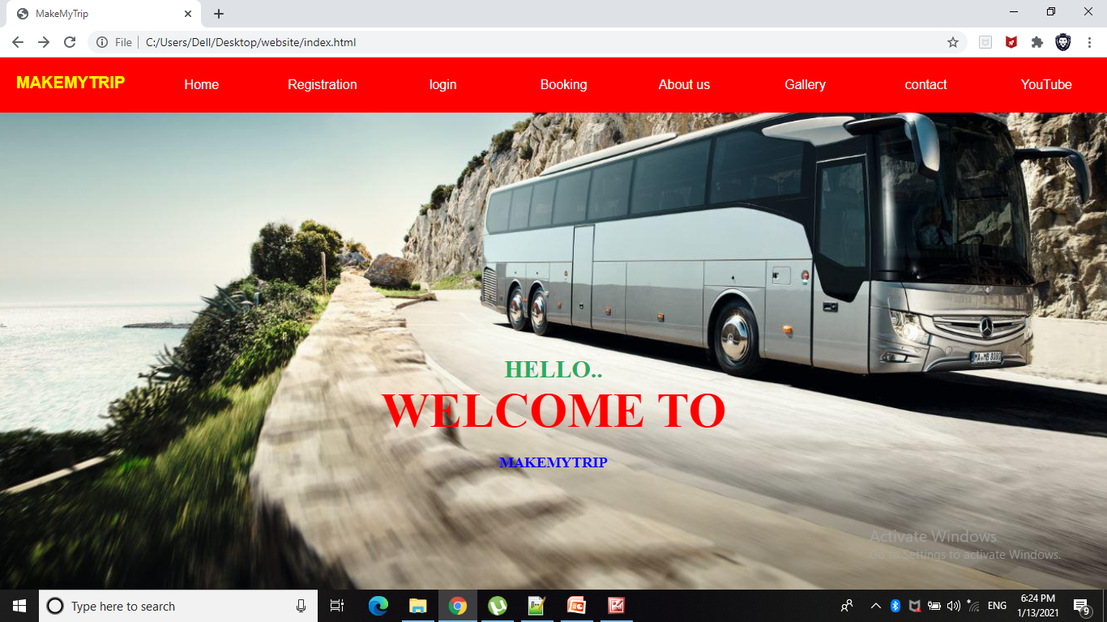
HOME PAGE
HOME PAGE

Slide 5
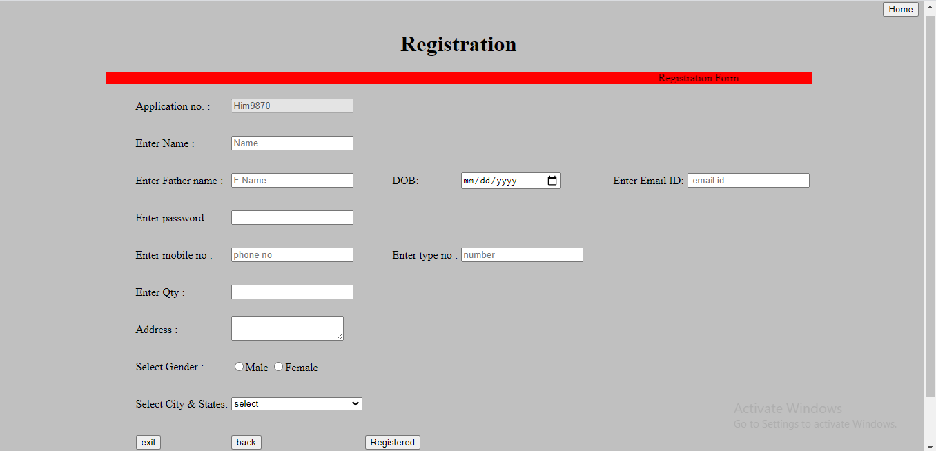
Registration

Slide 6
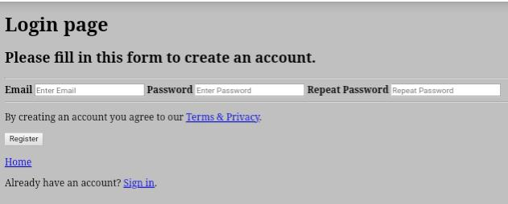

Slide 7
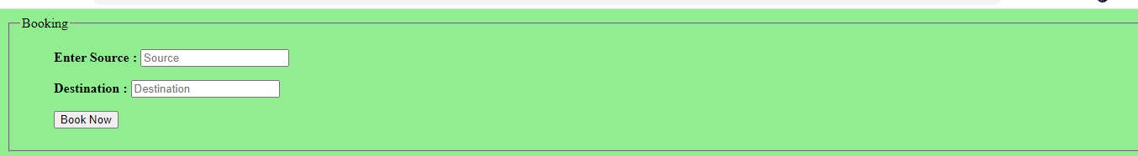
Booking

Slide 8
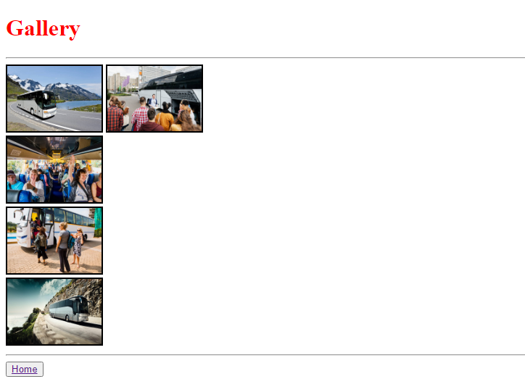

Slide 9
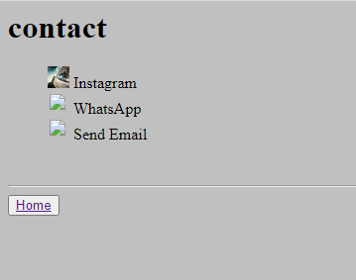

Slide 10
THANK YOU

